Slide 1
Mrs. Land
5th Grade
BLOCK 1 – Math, Science, Social Studies

Slide 2
Welcome to 2023-2024 Curriculum Night
welcome video

Slide 3
All About Me
Home:
Education/Career:
I’ve been married for 30 years.
Mike and I are both Atlanta natives, and we live in the Tucker/Stone Mountain area.
My husband also teaches in Fulton County! He is a PE teacher at Mimosa Elementary in Roswell.
Our favorite things are dogs, reading, cooking, and trying new restaurants. We love college sports but have different loyalties…I wear gold and Mike wears the dreaded red and black!
I have a BBA in Economics from Georgia State & an MBA from Georgia Tech.
I worked in marketing in the corporate world for 10 years.
Then, I went back to school to earn my Master’s Certification in Elementary Education at Mercer. I am also gifted certified.
This is my 27th year of teaching, and I’ve taught over 1,500 5th graders!!!!!

Slide 4
Home/School Communication
PawPrints Community Newsletter
This is a vital school information source
Emailed to all families every Friday
School Messenger Blasts & Web Page
Communicate timely messages to targeted audiences

Slide 5
Student/Teacher Communication
Announcements and homework are on the board
Verbally announced
Instructed to write information in agenda
SBCE website, Staff, Directory 5th Grade: Class Website http://landsbce.weebly.com/
Land’s Weekly Update emails sent every Friday

Slide 6
Expectations & Procedures
Expectations: BE S.M.A.R.T.
Say please and thank you!
Make friends and be thoughtful!
Arrive on time, prepared, and ready to learn!
Respect yourself and others!
Try your best!
Procedure:
Read and follow “Classroom Directions” displayed on the screen
Restroom with teacher’s permission

Slide 7
Notes:
The Fulton County Board of Education reviewed and revised the grading and reporting policy to ensure alignment and equality district-wide. The updated policy went into effect last August for all Fulton County schools.

Slide 8
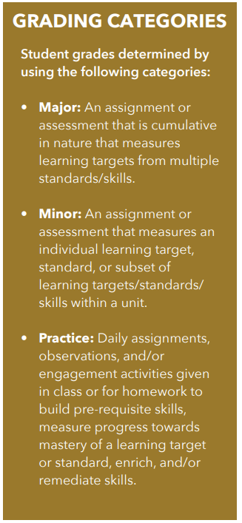
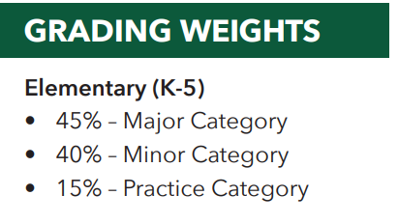
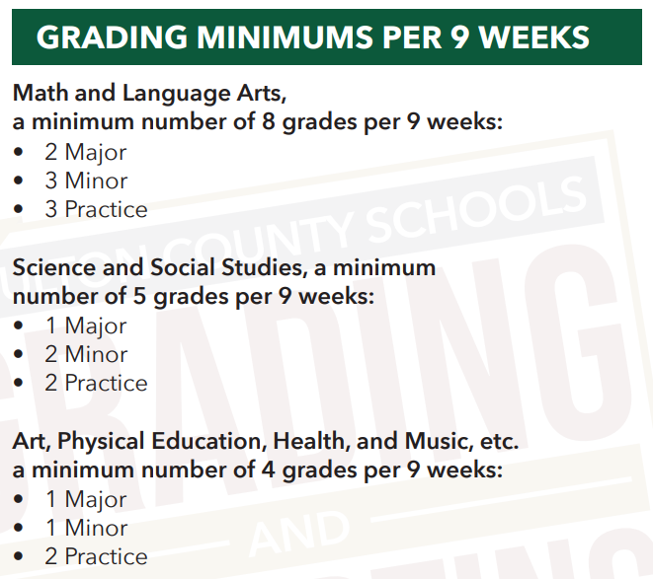
Grade calculation
Notes:
Student grades are determined by a combination of major, minor, and practice assignment grades. Major assignment are weighted the most because they are cumulative in nature (think test), while minor assignments measure only a single or small set of concepts (think quiz). Practice assignments are the daily classwork students complete. The established grading minimums ensure students have ample opportunities to show their progress over time.

Slide 9
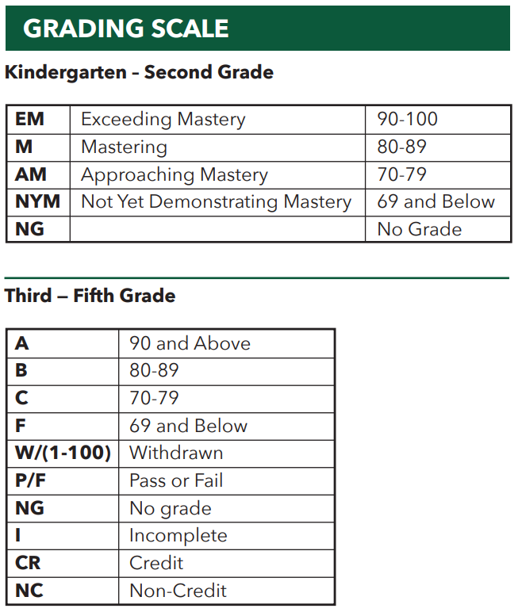
Grading scale
Notes:
The grading scale differs for K-2 and 3-5.

Slide 10
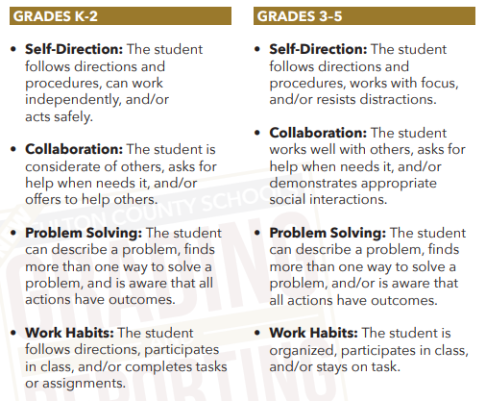
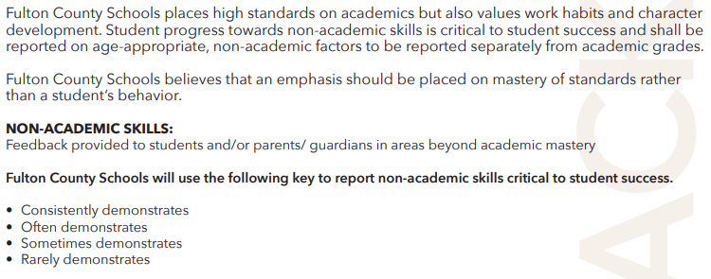
NON-ACADEMIC SKILLS?
Notes:
Feedback will be provided every 9 weeks in areas beyond academic mastery. These non-academic skills, focused on work habits and character development, are critical to student success.

Slide 11
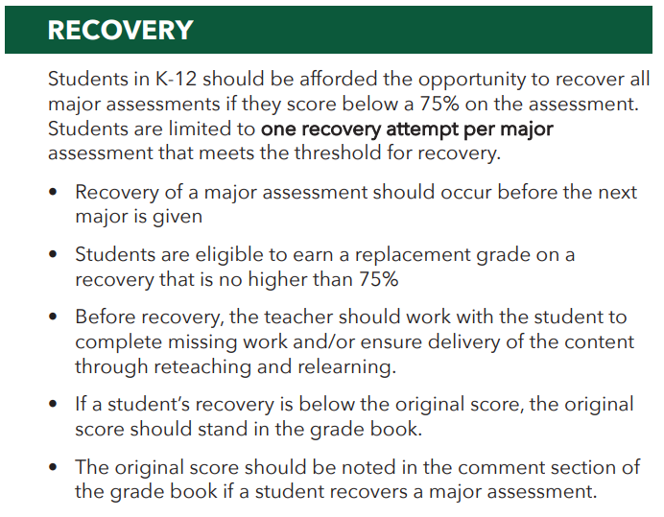
Notes:
Recovery offers students the opportunity to demonstrate improvement and mastery after reteaching. Let's read through these bullet points to better understand this policy.

Slide 12
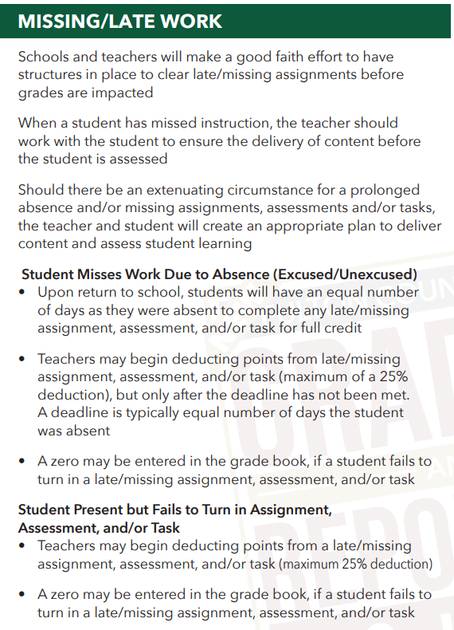
Notes:
We will always support students in completing missing work. This looks different for students who are absent, and students have an incomplete, missing, or late assignment.

Slide 13
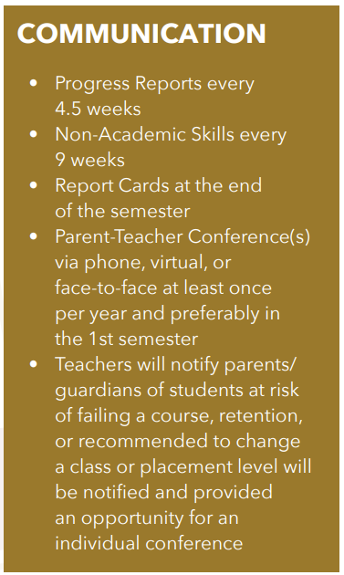
How will grades be communicated?
In between grade reports, student progress can be monitored through the Infinite Campus Parent Portal. Click the image below to set up your account.
Notes:
The Infinite Campus Parent Portal allows you to see assignment grades as they are posted, as well progress reports and report cards when they are issued. If you have not yet set up your portal access, I encourage you to click this icon when I send the presentation out to get yourself ready to go.

Slide 14
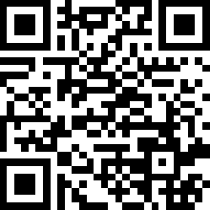
WHERE CAN I FIND more information?
fultonschools.org/gradingandreporting
Infographics by school level (elementary, middle, high) and topic
Answers to Frequently Asked Questions
All documents are available in:
English
Hindi
Korean
Chinese
Spanish
Please reach out if we can assist with another language.
Notes:
You can find all of the grading information shared today on the Fulton County website.

Slide 15
POSITIVE BEHAVIOR INTERVENTION & SUPPORTs

Slide 16
What is pbis?
PBIS is an evidence-based, data-driven framework proven to reduce disciplinary incidents, increase a school’s sense of safety, and support improved academic outcomes.

Slide 17
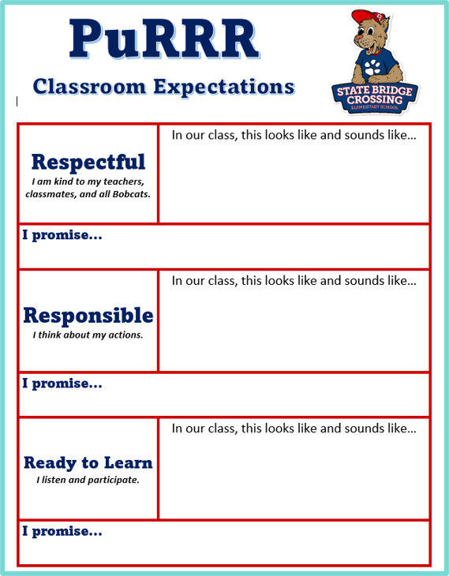
How do we teach PBIS expectations?
Students worked together to determine what
Respectful
Responsible
Ready to Learn
behavior LOOKS and SOUNDS like.
We then, as a class, created
‘I promise….’ statements
to help us remember how to display the best Bobcat behavior we can while at school.

Slide 18
Student & class recognition
Class Store
PawMart
Students and classes are rewarded and recognized for strong Bobcat behavior.
PURRR Points
Class Store
PawMart School Store
Hallway Heroes
Golden Spoon
Your child can access his or her PURRR Points via the PBIS Rewards icon in Classlink. Parents, be sure to add to the app to your phone, too!

Slide 19
Routines
A morning message is projected on the white board each morning and throughout the block to list materials and work assignments.
Tests are announced a week in advance​ and posted to my website.
Tests and quizzes are verbally announced, written on the board, and posted to my website​.
Classwork assignments will be graded as needed (weekly/biweekly) as a practice grade.
Notes and handouts are in students’ binder, block folders, or journals​.
Study guides/review sheets are extremely important and should be completed at home prior to review in class.​

Slide 20
Student Success
At School
At Home
Be at school unless sick
Be on time and avoid early dismissal is possible
Pay attention and remain on task
Ask questions!!!!
Use resources for help - notes, handouts, peer, teacher
Try your best!
Practice math daily (Knowledge of multiplication tables is critical to success.)
Review graded papers
Get plenty of sleep
Study for tests & quizzes
Complete homework assignments
Functional use of technology
Keyboarding
Save and open documents

Slide 21
Student Responsibilities at Home
Give parents all school communications sent home.
Use handouts, notes, and examples in class journals to do homework.
Do not expect parents to know what was taught in class.
Pack all school materials before bedtime.
Complete all homework.
Complete iReady online math practice.
Study for quizzes & tests.
Notes:
Friday learning is as important as any other day in the week. Everyone is excited that it is Friday, but we still need to be focused. If students are not following directions, and as a result do not complete their classwork, then there could be HW on the weekend. No one wants to do school work on a weekend, even teachers, so please remind your child to follow directions everyday.

Slide 22
Math
Math Mini Lesson
Math Journals/Interactive Notebooks
Quick checks - ticket in the door/out the door
Small flexible groups and one-on-one help
Homework may be assigned Monday through Thursday
iReady online math practice
Grades: practice, checkpoints, quizzes, unit tests
Notes:
Friday learning is as important as any other day in the week. Everyone is excited that it is Friday, but we still need to be focused. If students are not following directions, and as a result do not complete their classwork, then there could be HW on the weekend. No one wants to do school work on a weekend, even teachers, so please remind your child to follow directions everyday.

Slide 23
On/Enhanced 5th Grade Math
Unit 1: Investigating volume of solid figures Unit 2: Building conceptual understanding of place value using measurement and data reasoning Unit 3: Building conceptual understanding of multiplication and division with whole numbers Unit 4: Building fraction understanding Unit 5: Making sense of fraction multiplication and division Unit 6: Extending place value and working with decimals to solve problems Unit 7: Exploring geometry and the coordinate plane Unit 8: Culminating capstone unit

Slide 24
FCS Enhanced Mathematics
A Fulton County Board initiative that provides all students with the opportunity to take Algebra in Grade 8.
The Fulton County Board of Education is committed to the district’s Strategic Plan goal of preparing all students to graduate ready to pursue and succeed on their chosen path. To ensure that students have multiple paths open to them, taking Algebra I prior to 9th grade provides opportunities for enrollment in higher level math courses in high school.
With the roll-out of the new state math standards and state course pathways, Fulton County is enhancing on-grade level curriculum to include key standards from the next grade level that will build a solid foundation for Algebra in Grade 8. These standards are interwoven with grade level content to ensure a logical progression for conceptual understanding.

Slide 25
Additional Skills for Grade 5 Enhanced
Solve one-step equations and inequalities involving variables when values for the variables are given. Determine whether an equation and inequality involving a variable is true or false for a given value of the variable.
Explain the concept of a ratio, represent ratios, and use ratio language to describe a relationship between two quantities.
Determine greatest common factors and least common multiples using a variety of strategies to make sense of applicable problems.
Explore area as a measurable attribute of triangles, quadrilaterals, and other polygons conceptually by composing or decomposing into rectangles, triangles, and other shapes. Find the area of these geometric figures to solve problems.
Multiple and divide any combination of whole numbers, fractions, and mixed numbers using a student-selected strategy. Interpret products and quotients of fractions and solve word problems.

Slide 26
Science
Below are the topics for 5th grade:
Electricity and Magnetism
Cells & Microorganisms
Constructive and Destructive Forces
Chemical and Physical Changes
Classification, Plants & Animals from Different Regions; Genetics

Slide 27
Social Studies
Below are the topics for 5th grade:
Turn of the Century
World War I
The Great Depression
World War II
The Cold War
America Since 1975
Personal Finance

Slide 28
THANK YOU
For taking the time out of your evening to attend curriculum night 2023-2024. Write any questions you have on an index card or send an email. It is now time to switch to your child’s Block 2 teacher.

Slide 29
Mrs. Land
5th Grade
Block 2 - Math, Science, Social Studies

Slide 30
All About Me
Home:
Education/Career:
I’ve been married for 30 years.
Mike and I are both Atlanta natives, and we live in the Tucker/Stone Mountain area.
My husband also teaches in Fulton County! He is a PE teacher at Mimosa Elementary in Roswell.
Our favorite things are dogs, reading, cooking, and trying new restaurants. We love college sports but have different loyalties…I wear gold and Mike wears the dreaded red and black!
I have a BBA in Economics from Georgia State & an MBA from Georgia Tech.
I worked in marketing in the corporate world for 10 years.
Then, I went back to school to earn my Master’s Certification in Elementary Education at Mercer. I am also gifted certified.
This is my 27th year of teaching, and I’ve taught over 1,500 5th graders!!!!!

Slide 31
Student/Teacher Communication
Announcements and homework are on the board
Verbally announced
Instructed to write information in agenda
SBCE website, Staff, Directory 5th Grade: Class Website http://landsbce.weebly.com/
Land’s Weekly Update emails sent every Friday

Slide 32
Home/School Communication
PawPrints Community Newsletter
This is a vital school information source
Emailed to all families every Friday
School Messenger Blasts
Updated each Friday to communicate timely messages

Slide 33
Routines
A morning message is projected on the white board each morning and throughout the block to list materials and work assignments.
Tests are announced a week in advance​ and posted to my website.
Tests and quizzes are verbally announced, written on the board, and posted to my website​.
Classwork assignments will be graded as needed (weekly/biweekly) as a practice grade.
Notes and handouts are in students’ binder, block folders, or journals​.
Study guides/review sheets are extremely important and should be completed at home prior to review in class.​

Slide 34
Student Success
At School
At Home
Be at school unless sick
Be on time and avoid early dismissal is possible
Pay attention and remain on task
Ask questions!!!!
Use resources for help - notes, handouts, peer, teacher
Try your best!
Practice math daily (Knowledge of multiplication tables is critical to success.)
Review graded papers
Get plenty of sleep
Study for tests & quizzes
Complete homework assignments
Functional use of technology
Keyboarding
Save and open documents

Slide 35
Student Responsibilities at Home
Give parents all school communications sent home.
Use handouts, notes, and examples in class journals to do homework.
Do not expect parents to know what was taught in class.
Pack all school materials before bedtime.
Complete all homework.
Complete iReady online math practice.
Study for quizzes & tests.
Notes:
Friday learning is as important as any other day in the week. Everyone is excited that it is Friday, but we still need to be focused. If students are not following directions, and as a result do not complete their classwork, then there could be HW on the weekend. No one wants to do school work on a weekend, even teachers, so please remind your child to follow directions everyday.

Slide 36
Math
Math Mini Lesson
Math Journals/Interactive Notebooks
Quick checks - ticket in the door/out the door
Small flexible groups and one-on-one help
Homework may be assigned Monday through Thursday
iReady online math practice (when laptops are assigned)
Grades: practice, checkpoints, quizzes, unit tests
Notes:
Friday learning is as important as any other day in the week. Everyone is excited that it is Friday, but we still need to be focused. If students are not following directions, and as a result do not complete their classwork, then there could be HW on the weekend. No one wants to do school work on a weekend, even teachers, so please remind your child to follow directions everyday.

Slide 37
On/Enhanced 5th Grade Math
Unit 1: Investigating volume of solid figures Unit 2: Building conceptual understanding of place value using measurement and data reasoning Unit 3: Building conceptual understanding of multiplication and division with whole numbers Unit 4: Building fraction understanding Unit 5: Making sense of fraction multiplication and division Unit 6: Extending place value and working with decimals to solve problems Unit 7: Exploring geometry and the coordinate plane Unit 8: Culminating capstone unit

Slide 38
FCS Enhanced Mathematics
A Fulton County Board initiative that provides all students with the opportunity to take Algebra in Grade 8.
The Fulton County Board of Education is committed to the district’s Strategic Plan goal of preparing all students to graduate ready to pursue and succeed on their chosen path. To ensure that students have multiple paths open to them, taking Algebra I prior to 9th grade provides opportunities for enrollment in higher level math courses in high school.
With the roll-out of the new state math standards and state course pathways, Fulton County is enhancing on-grade level curriculum to include key standards from the next grade level that will build a solid foundation for Algebra in Grade 8. These standards are interwoven with grade level content to ensure a logical progression for conceptual understanding.

Slide 39
Additional Skills for Grade 5 Enhanced
Solve one-step equations and inequalities involving variables when values for the variables are given. Determine whether an equation and inequality involving a variable is true or false for a given value of the variable.
Explain the concept of a ratio, represent ratios, and use ratio language to describe a relationship between two quantities.
Determine greatest common factors and least common multiples using a variety of strategies to make sense of applicable problems.
Explore area as a measurable attribute of triangles, quadrilaterals, and other polygons conceptually by composing or decomposing into rectangles, triangles, and other shapes. Find the area of these geometric figures to solve problems.
Multiple and divide any combination of whole numbers, fractions, and mixed numbers using a student-selected strategy. Interpret products and quotients of fractions and solve word problems.

Slide 40
Science
Below are the topics for 5th grade:
Electricity and Magnetism
Cells & Microorganisms
Constructive and Destructive Forces
Chemical and Physical Changes
Classification, Plants & Animals from Different Regions; Genetics

Slide 41
Social Studies
Below are the topics for 5th grade:
Turn of the Century
World War I
The Great Depression
World War II
The Cold War
America Since 1975
Personal Finance

Slide 42
THANK YOU
For taking the time out of your evening to attend curriculum night 2023-2024. Write any questions you have on an index card or send an email.

